Slide 1
How do I know what to diagram?
Look for UI items that a user will interact with.
In the case of Turtle one, there are buttons that have ActionListeners associated to it.
You will want to sequence the flow with the ActionListeners.
// Define and initialize AWT buttons.
private Button penUpButton = toolControlPanel.getPenUpButton();
private Button penDownButton = toolControlPanel.getPenDownButton();
private Button turnRightButton = toolControlPanel.getTurnRightButton();
private Button turnLeftButton = toolControlPanel.getTurnLeftButton();
private Button moveButton = toolControlPanel.getMoveButton();
private Button printButton = toolControlPanel.getPrintButton();
private Button endButton = toolControlPanel.getEndButton();

Slide 2
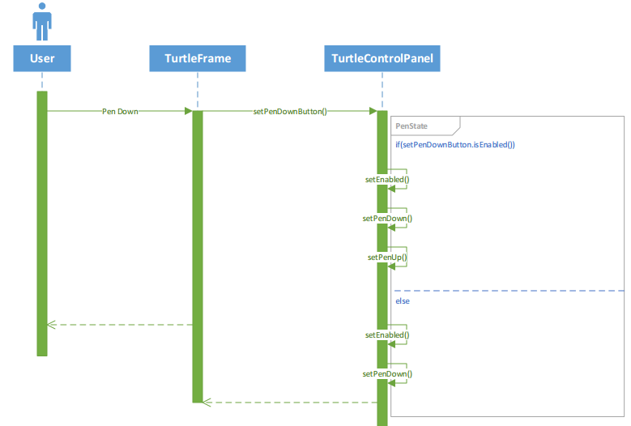
Turtle1 > Pen Down
TurtleFrame.java contains the code which support the actions relating to when a user triggers the Pen Down activity (via the PenDown button).
That means that after the user, the next Object LifeLine should be TurtleFrame.
Reading the code for PenDownButton (in TurtleFrame), additional actions are coded in toolControlPanel
// Define an event listener for the penDownButton.
penDownButton.addActionListener(
new ActionListener()
{
public void actionPerformed(ActionEvent e)
{
// Alter state of button and related buttons.
toolControlPanel.setPenDownButton();
} // End of actionPerformed method.
}); // End of commands action listener.
toolControlPanel is a dependent class (as initialized at the top of the TurtleFrame.java code)
// Define objects on dependent classes.
private TurtleControlPanelOne toolControlPanel = new TurtleControlPanelOne();
That means that the next Object Lifeline after TurtleFrame should be TurtleControlPanel

Slide 3
Turtle1 > Pen Down
In TurtleControlPanel, if/case statements need to be in a loop fragment
// Define method to set button enablement state.
protected void setPenDownButton()
{
// Evaluate state of button enablement and alter it.
if (penDownButton.isEnabled())
{
// Disable penDownButton and enable penUpButton.
penDownButton.setEnabled(false);
setPenDown();
setPenUpButton();
}
else
{
// Enable penDownButton.
penDownButton.setEnabled(true);
setPenDown();
} // End of if to alter enabled state.
} // End of setPenDownButton() method.
The message stays within TurtleControlPanel

